Slide 1
How (and why) to Eliminate “to be” Verbs
Because nobody likes a boring essay!

Slide 2
To Be or Not to Be?
Didn’t Shakespeare say “To be, or not to be: that is the question:”? He used three “to be” verbs right there! If it’s good enough for Shakespeare, it’s good enough for me.
Remember Shakespeare used only six more “to be” verbs in Hamlet’s next 34 lines.

Slide 3
“to be”
am
is
were
are
was
be
being
been

Slide 4
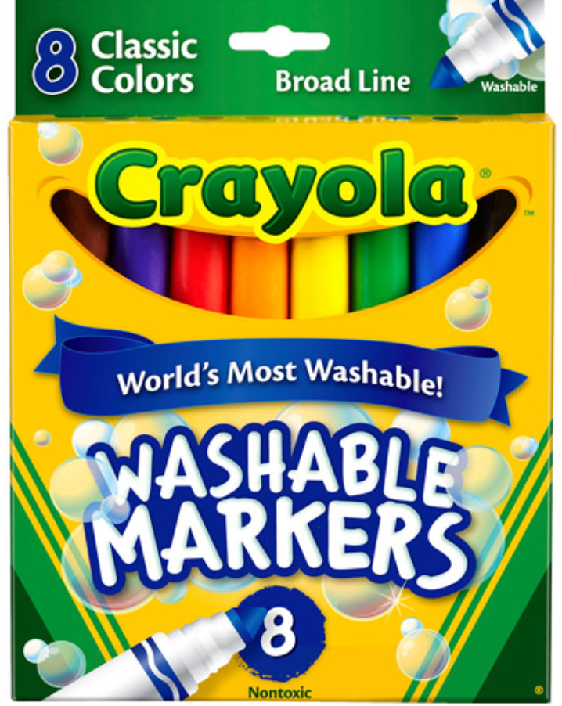
What’s So Wrong with “To Be” Verbs?
They unduly claim a degree of permanence.
For example, “I am hungry.” For most Americans, hunger is only a temporary condition.

Slide 5
What’s So Wrong with “To Be” Verbs?
They claim absolute truth and exclude other views.
“Classical music is very sophisticated.” Few would agree that all classical compositions are always sophisticated.

Slide 6
What’s So Wrong with “To Be” Verbs?
They are general and lack specificity.
A mother may tell her child, “Be good at school today.” The more specific “Don’t talk when the teacher talks today” would probably work better.

Slide 7
What’s So Wrong with “To Be” Verbs?
They are vague.
For example, “That school is great.” Clarify the sentence as “That school has wonderful teachers, terrific students, and supportive parents.”

Slide 8
What’s So Wrong with “To Be” Verbs?
They often confuse the reader about the subject of the sentence.
For example, “It was nice of you to visit.” Who or what is the “It?”

Slide 9
How can I eliminate “to be” verbs?

Slide 10
Identify
Memorize the “to be” verbs to avoid using them and to revise those used in essays: is, am, are, was, were, be, being, been.
Self-edit by circling “to be” verbs in the revision stage of writing.
Problem-solve whether a “to be” verb is necessary or not.

Slide 11
Substitute
Sometimes a good replacement of a “to be” verb just pops into the brain. For example, instead of “That cherry pie is delicious,” substitute the “to be” verb is with tastes as in “That cherry pie tastes delicious.”
Also, substitute the “there,” “here,” and “it” + “to be” verbs. For example, instead of “There is the cake, and here are the pies for dessert, and it is served by Mom,” replace with “Mom serves the cake and pies for dessert.”
Let’s also add on the “this,” “that,” “these,” and “those” + “to be” verbs.
Finally, strong linking verbs can replace “to be” verbs. For example, instead of “That was still the best choice,” substitute the “to be” verb was with the linking verb remained as in “That remained the best choice.”

Slide 12
Convert
Start the sentence differently to see if this helps eliminate a “to be” verb.
For example, instead of “Charles Schulz was the creator of the Peanuts cartoon strip,” convert the common noun creator to the verb created as in “Charles Schulz created the Peanuts cartoon strip.”

Slide 13
Change
To eliminate a “to be” verb, change the subject of the sentence to another noun or pronoun in the sentence and rearrange the order of the sentence. For example, instead of “The car was stopped by a police officer,” change the complete subject, the car, to a police officer to write “A police officer stopped the car.”
Also, add in a different sentence subject to eliminate a “to be” verb. For example, instead of “The books were written in Latin,” add in a different sentence subject, such as “authors” to change the passive voice to the active voice and write “Authors wrote the books in Latin.”
Lastly, starting the sentence with a different word or part of speech will help eliminate the “to be” verb. For example, instead of “The monster was in the dark tunnel creeping,” rearrange as “Down the dark tunnel crept the monster.”

Slide 14
Combine
Look at the sentences before and after the one with the “to be” verb to see if combining the sentences will eliminate the “to be” verb.
For example, instead of “The child was sad. The sensitive child was feeling that way because of the news story,” combine as “The news story saddened the sensitive child.”

