Slide 1
Vocabulary Level G
Unit 1

Slide 2
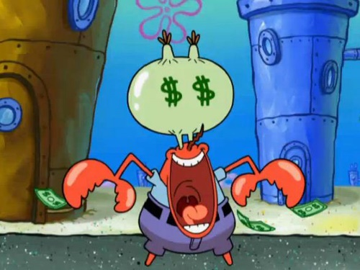
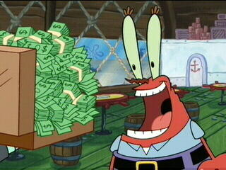
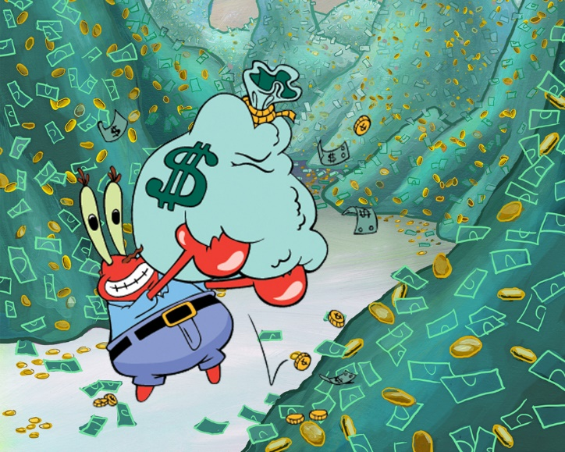
ACQUISITIVE
Connotation: Negative
Etymology:1630s, "owned through acquisition," from L. acquisitivus, of acquirere. Meaning "given to acquisition, avaricious "is from 1826 (in acquisitiveness).
Word Structure: Suffix –ive means “having the quality of”

Slide 3
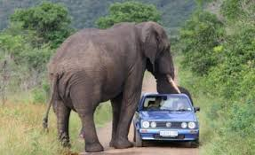
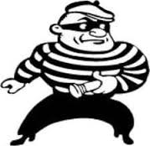
Arrogate
Connotation: Negative
Etymology: from Latin arrogāre, from rogāre to ask; past participle of arrogare"to claim for oneself" (see arrogance )

Slide 4
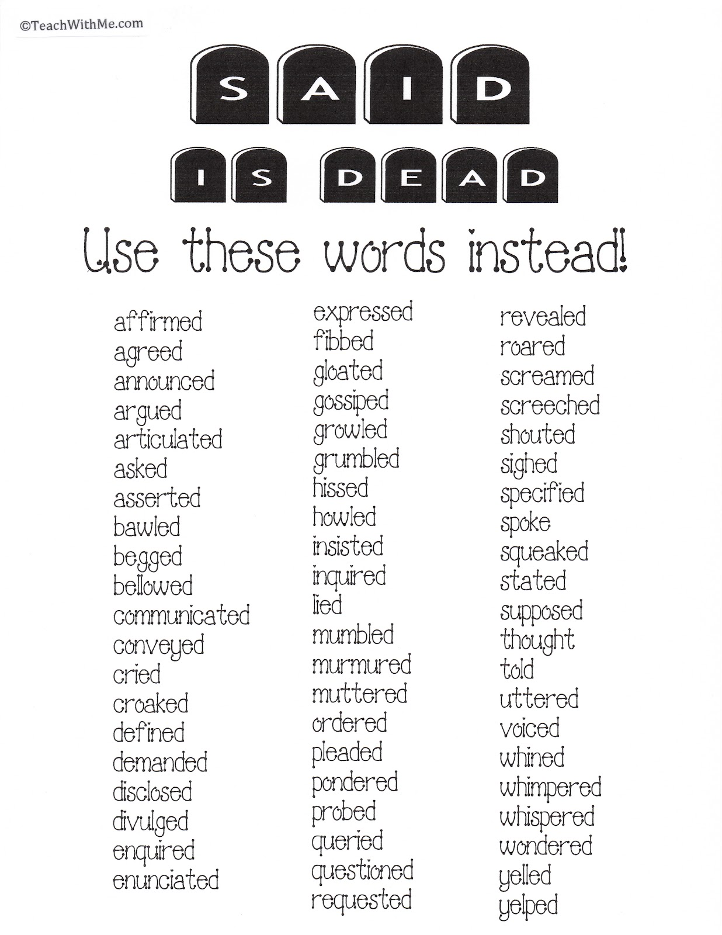
Banal
Connotation: negative
Etymology: relating to compulsory feudal service, hence common to all, commonplace
Word Structure: -al means of the kind of, pertaining to, having the form or character of

Slide 5
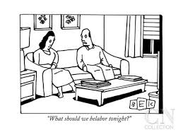
Belabor
Connotation: negative
Etymology: c.1600, "to exert one's strength upon," from be + labor. But figurative sense of "assail with words" is attested somewhat earlier(1590s).

Slide 6
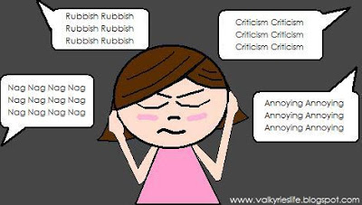
Carping
Connotation: negative
Etymology: Old Norse karpa to boast; related to Latin carpere to pluck

Slide 7
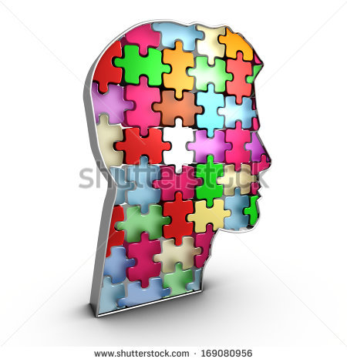
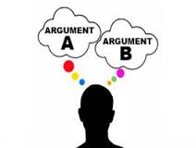
Coherent
Connotation: Positive
Etymology: Latin "cohere," from com- "together" (see co-) + haerere "to stick"

Slide 8
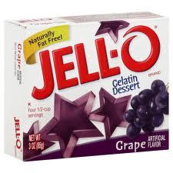
Congeal
Connotation: neutral
Etymology: Latin congelāre, equivalent to con- + gelāre to freeze;
Word Structure: prefix –con means together; with; jointly commingle

Slide 9
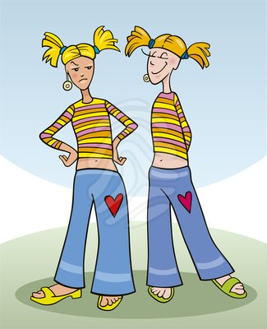
Emulate
Connotation: Positive
Etymology:from L. aemulat, pp. stem of aemulari "to
rival" (see emulation).
Word Structure: prefix em- means “into,” suffix –ate means “cause to be, office of”

Slide 10
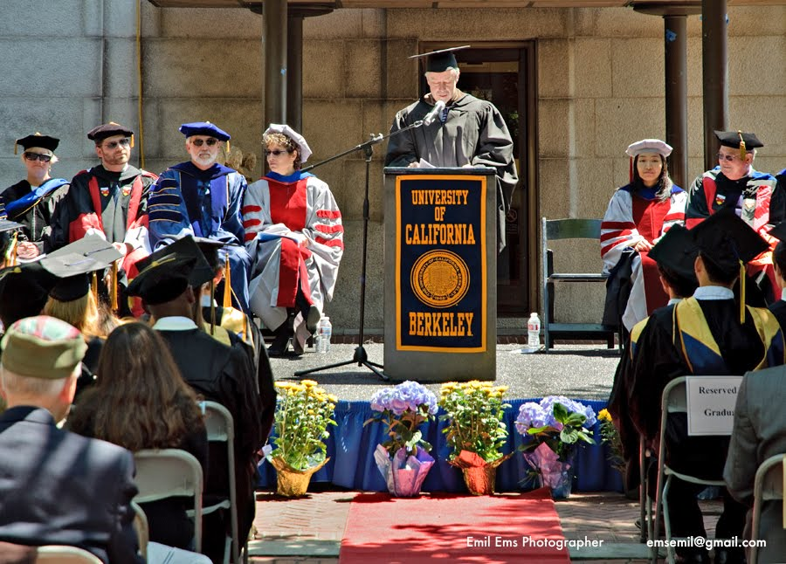
Encomium
Connotation: positive
Etymology: from Gk. enkomion (epos) "laudatory(ode), eulogy," from en"in" + komos "banquet, procession, merrymaking.“
Word Structure: prefix en- means “into,” noun suffix –ium means “metallic element”

Slide 11

Eschew
Connotation: negative
Etymology:mid14c., from O.Fr. eschiver, from Frankish *skiuhan "dread,avoid, shun" (cf. O.H.G. sciuh"make fearful"), from P.Gmc.*skeukhwaz.
Word Structure: prefix es- means “moving away,” suffix

Slide 12
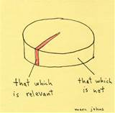
Germane
Connotation: Positive
Etymology: "having the same parents," derived from german (adj.); cf. human/humane, urban/urbane. Main modern sense of "closely connected, relevant“

Slide 13
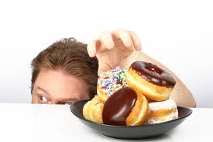

Insatiable
Connotation: Negative (usually)
Etymology: Latin insatiabilis "not to be satisfied," from in- "not, opposite of" (see in- (1)) +satiabilis, from satiare (see satiate)

Slide 14
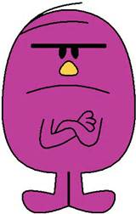
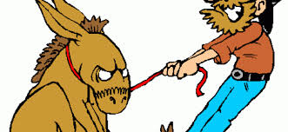
Intransigent
Connotation: Negative
Etymology: Latin transigere to settle; see transact
Word Structure: The prefix IN- means not. The suffix GENT- means one who.

Slide 15
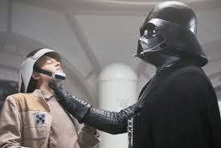
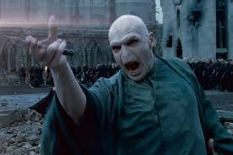
Invidious
Connotation: negative
Etymology: 1600–10; < Latin invidiōsus envious, envied, hateful, equivalent to invidi ( a ) envy + -ōsus -ous

Slide 16
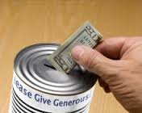
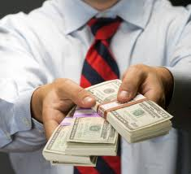
Largesse
Connotation: Positive
Etymology: also largess, "willingness to give or spend freely; munificence," c.1200, from Old French largesse "a bounty, munificence," from Vulgar Latin *largitia “abundance”.

Slide 17
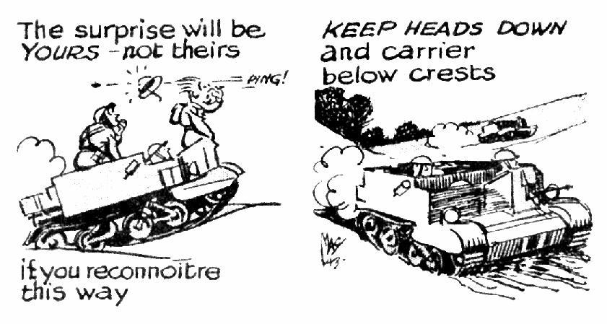
Reconnaissance
Connotation: Positive/Neutral
Etymology: 1810, from French reconnaissance "act of surveying," literally "recognition," from Old French reconoissance "recognition, acknowledgement“
Word Structure: Root word is recon meaning “the exploration of an area to gain information”.

Slide 18
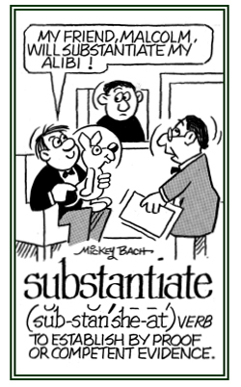
Substantiate
Connotation: Positive
Etymology: 1650s, "to make real, to give substance to," from Modern Latin substantiatus, past participle of substantiare, from Latin substantia "being, essence, material" (see substance). Meaning "to demonstrate or prove" is attested from 1803.
Word Structure: Root word is sub, meaning “under or beneath”.

Slide 19
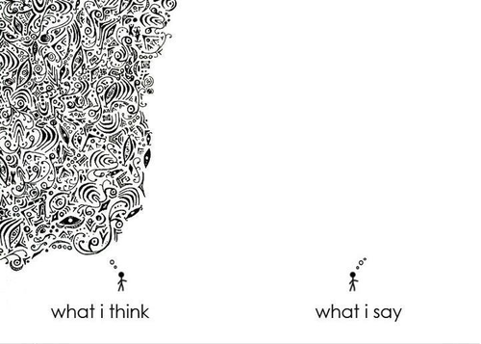
Taciturn
Connotation: Negative
Etymology: Latin taciturnus, quiet, maintaining silence,
equivalent to tacit (us) silent (see tacit ) +
-urnus adj.suffix of time

Slide 20
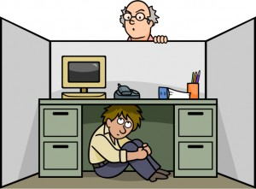
Temporize
Connotation: Negative
Etymology: Medieval Latin temporizāre to hang back,delay, equivalent to Latin tempor- (stem of tempus) time

Slide 21
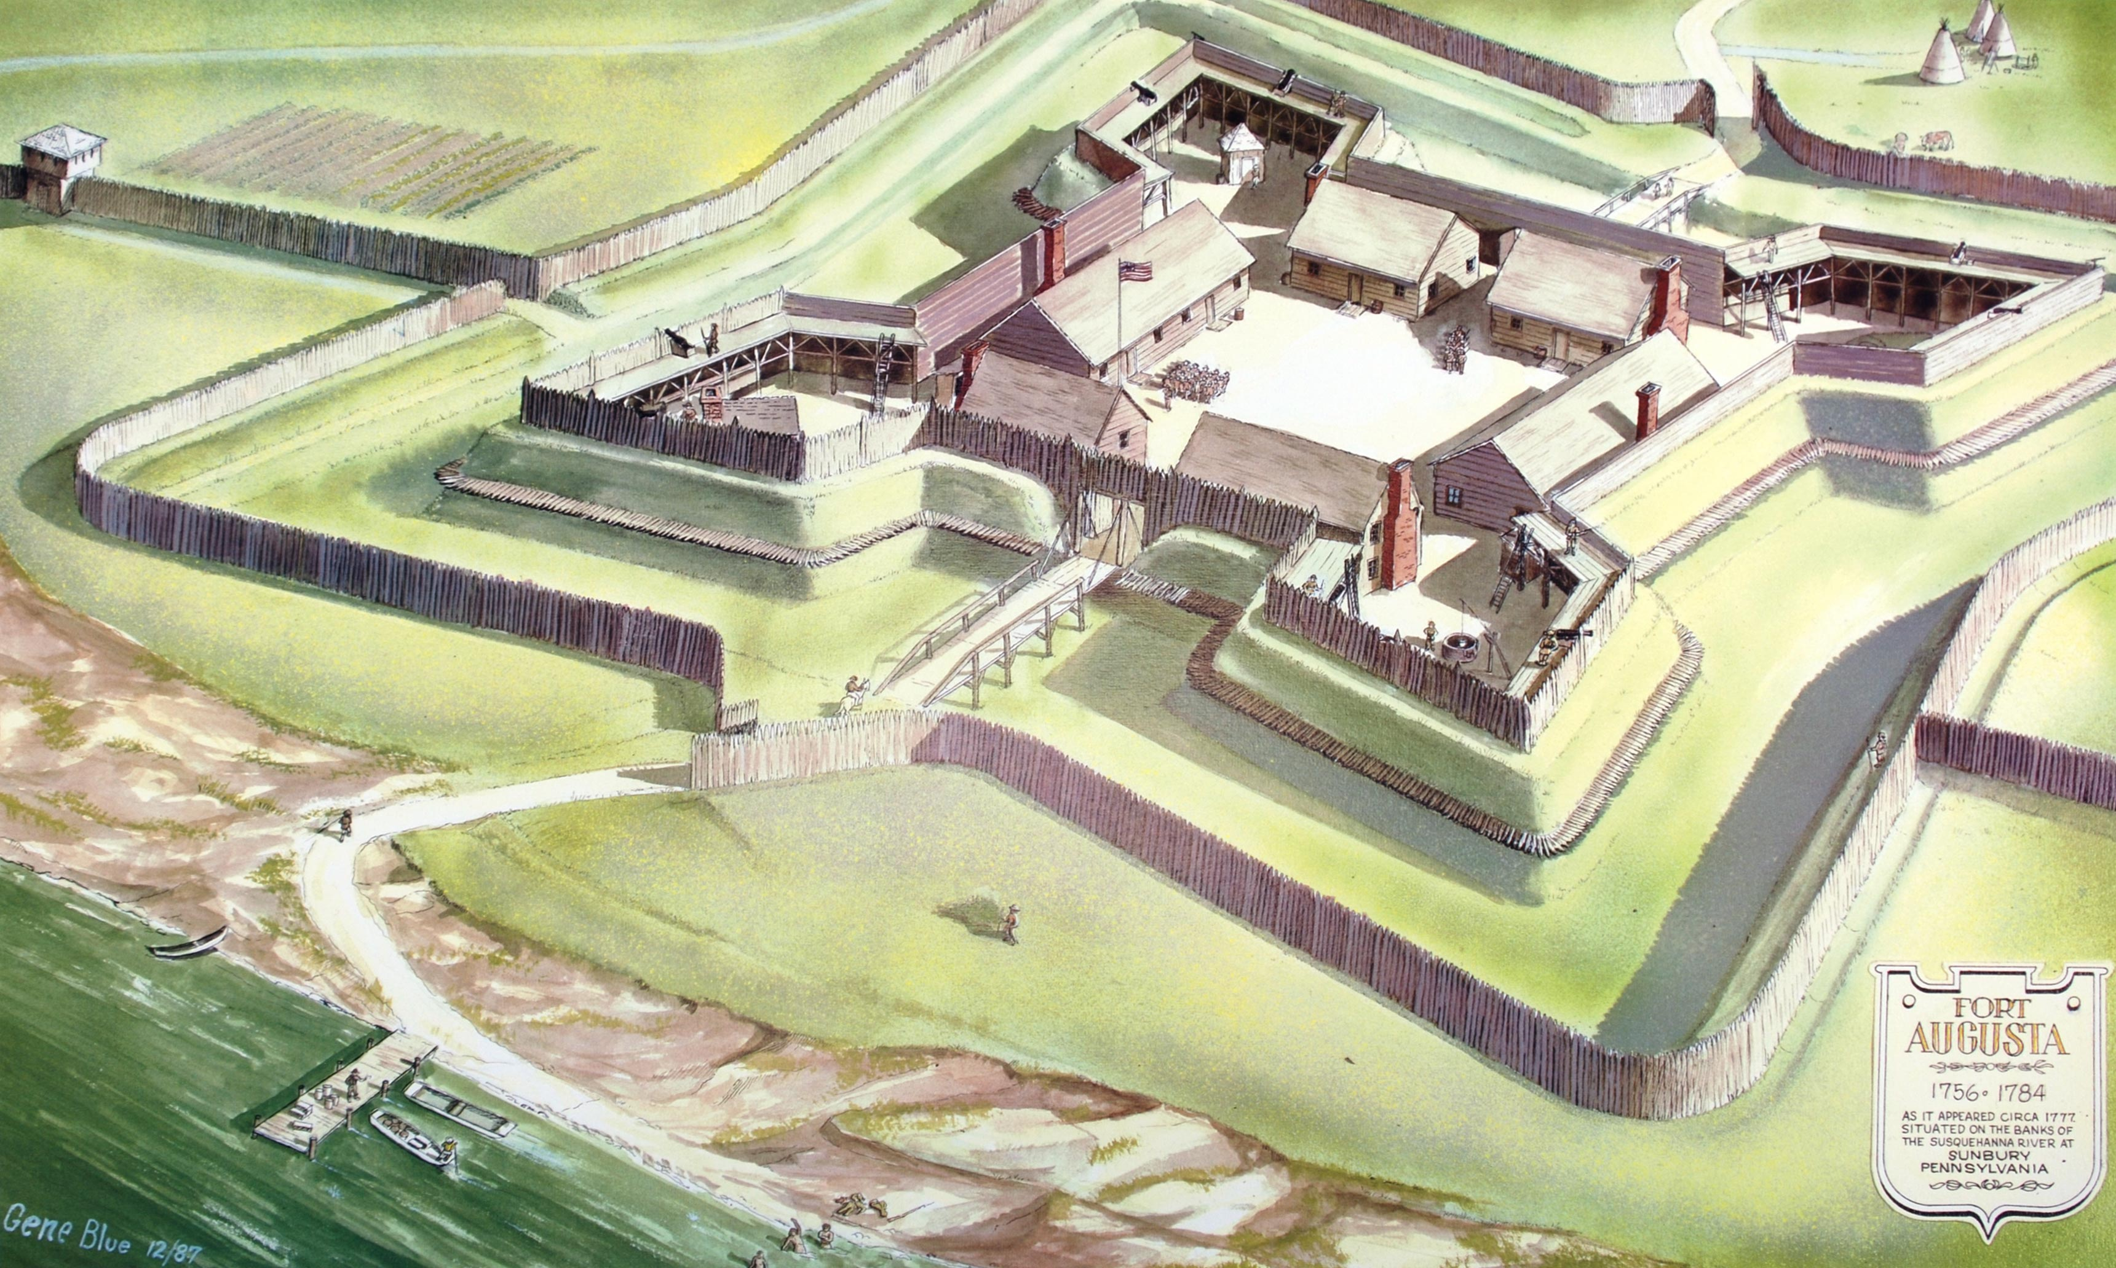
Tenable
Connotation: Positive
Etymology: French: that can be held, equivalent to ten(ir) to hold (≪ Latin tenēre) + -able -able

