Slide 1
Vocabulary Level G
Unit 2

Slide 2
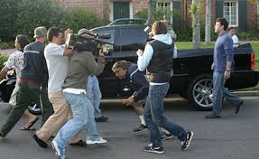
Accost
Connotation- negative
Etymology- from Late Latin accostāre to place side by side, from Latin costa side, rib

Slide 3
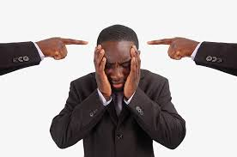
animadversion
Connotation- negative
Etymology- Latin animadversiōn- (stem of animadversiō) a heeding, censure, equivalent to animadvers (us) (past participle of animadvertere to heed, censure; animus (dislike)+ advertere (to advert)

Slide 4
avid
Connotation-neutral
Etymology- L. avidus "longing eagerly for," from avere "to desire eagerly.“

Slide 5
BRACKISH
Connotation: Negative
Etymology: from Middle Dutch brac salty; 1530s, from Scottish brack "salty"

Slide 6
CELERITY
Connotation: Positive
Etymology: Latin from celer swift

Slide 7
DEVIOUS
Connotation: Negative
Etymology: L. devius "out of the way, remote," from de via (see deviate ).

Slide 8
Gambit
Connotation: Positive
Etymology: from Italian gambetto, literally "a tripping up"(as a trick in wrestling), from gamba "leg"

Slide 9
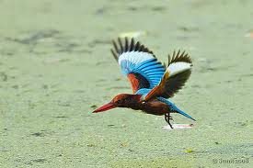
Halcyon
Connotation: Positive
Etymology: Latin alcyon, from Greek alkuōn kingfisher bird
Mythology: Ceyx and Alcyone

Slide 10
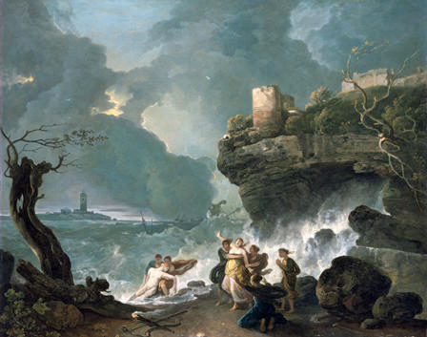
The Myth of Ceyx and Alcyone
In Greek mythology, the goddess Halcyon (Alcyone in Greek) was the daughter of Aeolus, the ruler of the winds. Aeolus lived in the caves, where winds were imprisoned. He chose when to let them out, depending on how the higher gods instructed him.
Halcyon was married to the mortal king Ceyx of Tachis. Their love for each other was well known. Once, when Ceyx had to go to Delphi to consult the oracle of Apollo, he chose to sail despite all the cries of his beloved Halcyon, who was terribly afraid of the sea.
Halcyon proved right because Ceyx drowned when a huge storm took his life not far from the coast and his boat disappeared in the waves.
Trying to fight the storm, aware that he was to drown, Ceyx asked Poseidon (the sea god) to bring his body to his wife’s arms. In the meantime, afraid for her husband and not knowing yet what had happened, Halcyon asked Hera to ensure his safe trip.
It was too late and Hera had no choice but to send for Hypnos, who instructed Morpheus, the God of Dreams, to appear to the poor woman and tell her about the tragedy. The desperate Halcyon went to the coast where she found Ceyx’s body and threw herself into the dark waves. Amazed by her love and devotion, the gods decided to save her and to transform her into a seabird. They also turned Ceyx into another kingfisher so the two could live and be together.

Slide 11
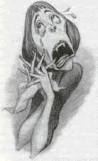
Histrionic
Connotation: Negative
Etymology: Latin histrōnicus of actors, stem of histriō actor

Slide 12
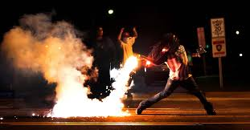
Incendiary
Connotation: Negative
Etymology: Latin incendiārius, equivalent to incendi(um) a fire; from base of candēre to shine, be hot

Slide 13
Maelstrom
Connotation: negative
Etymology: late 17th century: from early modern Dutch (denoting a mythical whirlpool supposed to exist in the Arctic Ocean, west of Norway), from maalen ‘grind, whirl’ + stroom ‘stream.’

Slide 14
Myopic
Connotation: Negative
Etymology: "short-sightedness," 1727, medical Latin, from Late Greek myopia "near-sightedness," from myops "near-sighted," literally "closing the eyes," from myein "to shut"
Word Structure: prefix my(o)- means “muscle,” suffix –ic means “of or relating to”

Slide 15
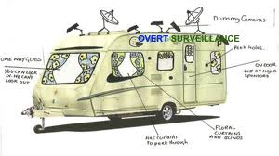
Overt
Connotation: Positive
Etymology:early 14c., "open to view," from Old French ovrir "to open," from Latin aperire "to open, uncover,"

Slide 16
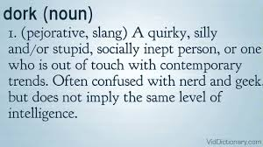
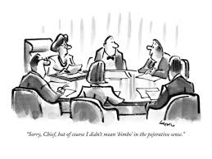
Pejorative
Connotation: Negative
Etymology: Latin pejorare ‘make worse,’ from Latin pejor ‘worse.’

Slide 17
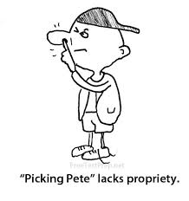
Propriety
Connotation: Positive
Etymology: Latin proprietās peculiarity, ownership, equivalent to propri (us) proper

Slide 18
Sacrilege
Connotation: Negative
Etymology: Latin sacrilegium, equivalent to sacri- (combining form of sacrum holy place) + leg (ere) to steal, literally, gather

Slide 19
Summarily
Connotation: Neutral
Etymology: from summary + -ly

Slide 20
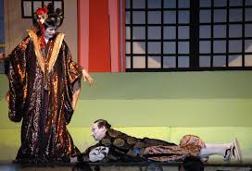
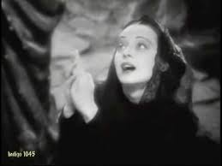
Suppliant
Connotation: Neutral
Etymology: French supplier to beseech, from Latin supplicāre to kneel in entreaty; see supple

Slide 21
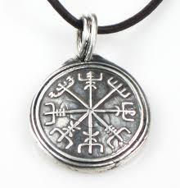
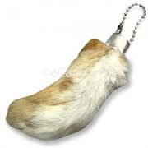
Talisman
Connotation: Neutral
Etymology: Arabic tilsam, from Medieval Greek telesma ritual, from Greek: consecration, from telein to perform a rite, complete, from telos end, result

Slide 22
Undulate
Connotation: Neutral
Etymology: Latin undulātus waved, equivalent to und(a) wave + -ul (a) -ule + -ātus

