Slide 1
Vocabulary Unit 3
Level G

Slide 2
Cavort
Positive
1793, cauvaut, Amer.Eng., probably from ca- colloquial intens. prefix + vault "jump, leap."

Slide 3

Credence
Connotation: Positive
Etymology: Middle English: via Old French from medieval Latin credentia, from Latin credent- ‘believing,’ from the verb credere .

Slide 4
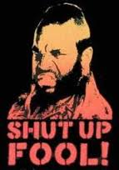
Decry
Connotation: negative
Etymology: 1610-20; French décrier, Old French descrier
Word Structure: prefix de- indicates removal, negation

Slide 5
Dissemble

Slide 6
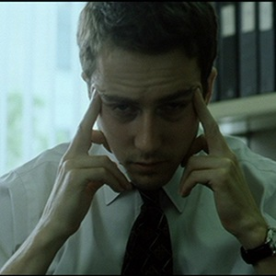
Distraught
Connotation: Negativve
Etymology: late Middle English: alteration of the obsolete adjective distract (from Latin distractus “pulled apart”), influenced by straught, archaic past participle of stretch.
Word Structure: prefix dis- means oppisite of; -straught means to make straight

Slide 7
Eulogy

Slide 8
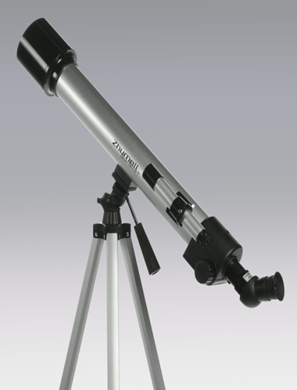
Evince
Connotation: positive
Etymology: late 16th century (in the sense ‘prove by argument or evidence’): from Latin evincere ‘overcome, defeat’ (see evict).

Slide 9
Exhume

Slide 10
Feckless

Slide 11
Murky

Slide 12
Nefarious

Slide 13
Piquant

Slide 14
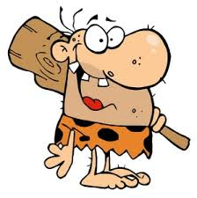
Primoridal
Connotation: Neutral
Etymology: late 14c., from L.L. primordialis "first of all, original," from L. primordium "the beginning," from primus "first" (see prime (adj.)) + stem of ordiri "to begin“

Slide 15

Propinquity
Connotation: Neutral
Etymology: Middle English propinquite < Latin propinquitās nearness, equivalent to propinqu (us) near ( prop (e) near (see pro-1) + -inquus adj. suffix) + -itās -ity

Slide 16
Substantive
Connotation: neutral
Etymology: 1350-1400; Middle English > Late Latin substantīvus, equivalent to Latin substant (ia) substance + -īvus –ive

Slide 17
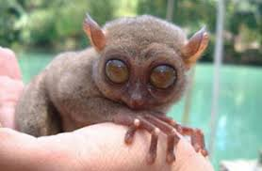
Unwonted
Connotation: Negative
Etymology: "not usual," 1553, from un- (1) "not" + pp. of wont.

Slide 18
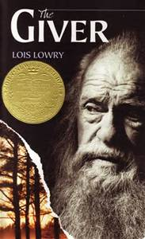

Utopian
Connotation: Neutral
Etymology: Utopia, imaginary and ideal country in Utopia (1516) by Sir Thomas More, from Greek ou not, no + topos place. First Known Use: 1597

Slide 19
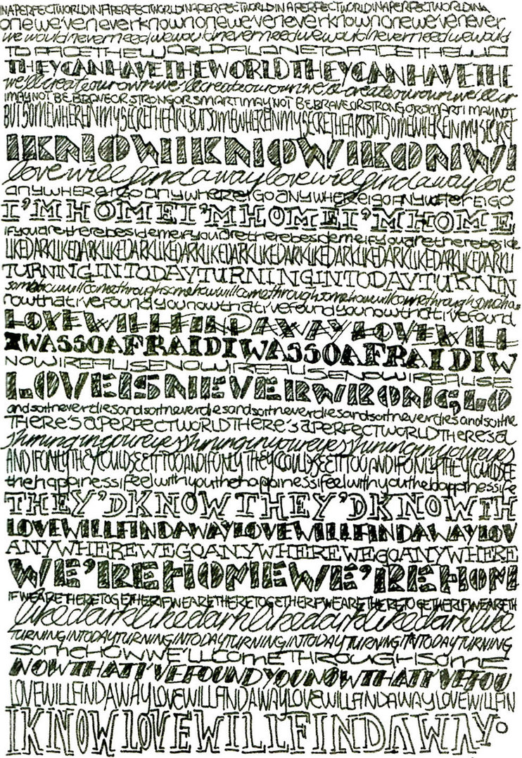
Verbiage
Connotation: Negative
Etymology: "abundance of words," 1721, from French verbiage "wordiness" (17c.), from Middle French verbier "to chatter," from Old French verbe "word," from Latin verbum "word"

Slide 20
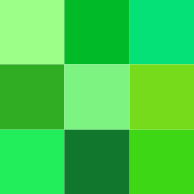
Verdant
Connotation: Neutral
Etymology: From Middle French verdoyant, from Old French verb verdier, verdoier, from vert (“green”), from Vulgar Latin *virdis, from Latin viridis.

Slide 21
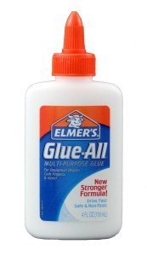
Viscous
Connotation: Neutral
Etymology: late 14c., from Anglo-French viscous and directly from Late Latin viscosus "sticky," from Latin viscum "anything sticky, birdlime made from mistletoe, mistletoe," probably from PIE root *weis- "to melt away, flow“

