Slide 1
Level G
Unit 5

Slide 2
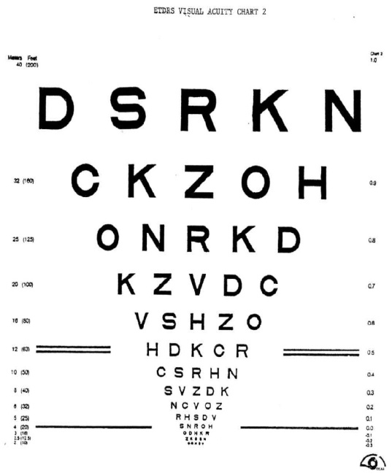
acuity
Positive
Etymology- Latin acuere “sharpness or acuteness”
Word Structure- “-ity”:
a suffix used to form abstract
expressing state or condition:

Slide 3
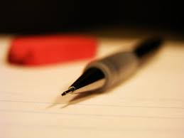
Delineate
Neutral
Etymology- Latin from de- linea line “portray or sketch”
Word structure- “-ate”: possessing; having the appearance or characteristics of fortunate,

Slide 4
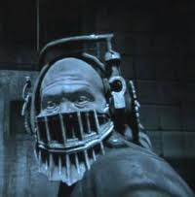
Depraved
Connotation: negative
Etymology: Latin dēprāvāre to pervert, corrupt, equivalent to dē- + prāv crooked

Slide 5
Enervate
Negative
Etymology- c.1600, from Latin enervatus "to weaken"

Slide 6
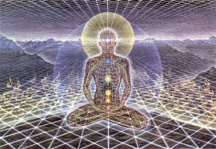
Esoteric
Connotation:
negative
Etymology: from Greek esōterikos,
“eso-” meaning “inner”,
”-teric” being the comparitive form of the word it applies to

Slide 7
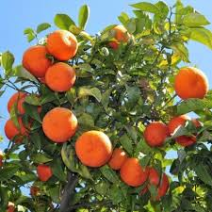
Fecund
Connotation: positive
Etymology: Latin fēcundus,
equivalent to fē- (see fetus ) + -cundus adj. suffix

Slide 8
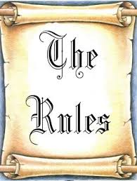
FIAT
Connotation: negative
Etymology: from Latin, ‘let it be done,’ from fieri ‘be done or made.’

Slide 9
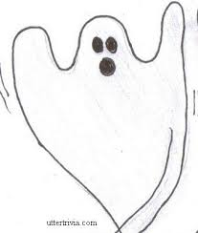
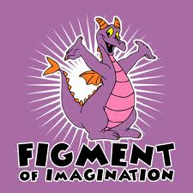
FIGMENT
Connotation: neutral
Etymology: from Latin figmentum, related to fingere ‘form, contrive.’ Compare with feign and fiction.

Slide 10
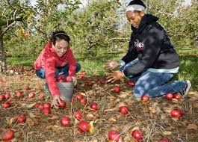
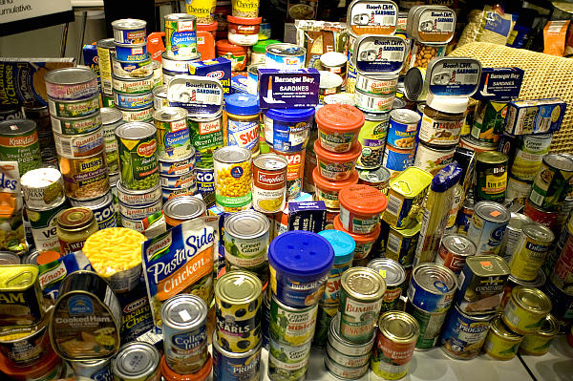
GARNER
Connotation: Positive
Etymology: Latin granarium ‘granary,’ from granum ‘grain.’

Slide 11
hallow
Connotation: Positive
Etymology: Old English halgian "to make holy, to honor as holy, consecrate, ordain," related to halig "holy," from PIE root *kailo- "whole, uninjured, of good omen" (see health).

Slide 12
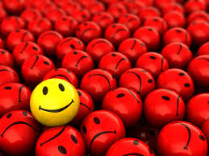
Idiosyncrasy
Neutral
Etymology: Greek idiosunkrasia, from idio- + sunkrasis mixture, temperament, from sun- syn- + kerannunai to mingle

Slide 13
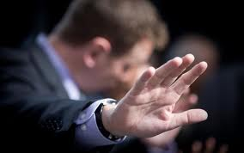
Ignominy
Connotation: negative
Etymology: Latin ignōminia, (apparently by association with ignōbilis ignoble) + nōmin- (stem of nōmen) name + -ia -y3

Slide 14
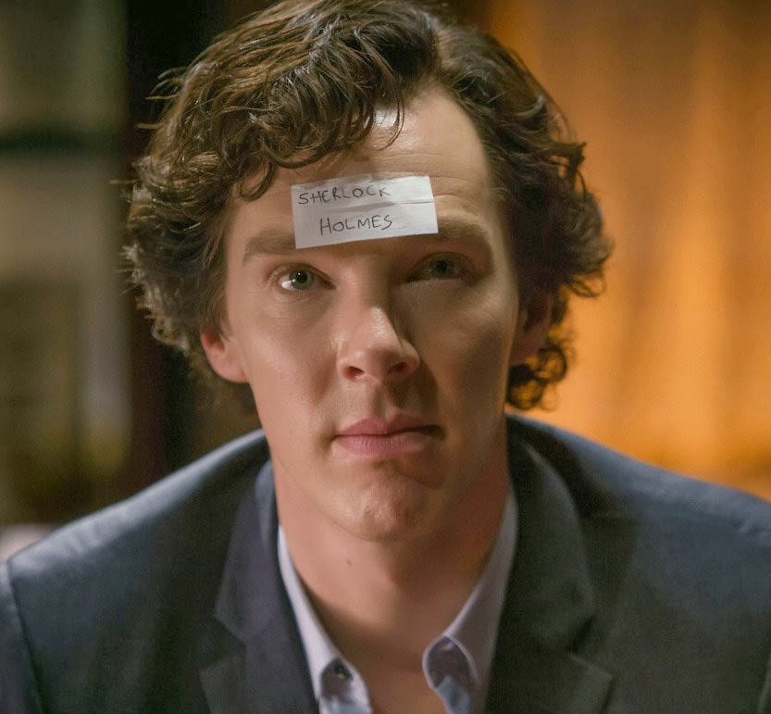
Mundane
Connotation: Negative
Etymology: mid-15c., from Old French mondain "of this world, worldly, earthly, secular;" from Late Latin mundanus "belonging to the world"

Slide 15
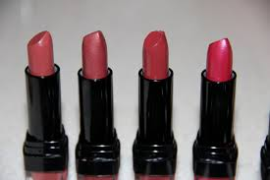
Nuance
Connotation: neutral
Etymology: French: shade, hue, equivalent to nu (er) to shade (literally, to cloud < Latin nūbēs cloud)

Slide 16
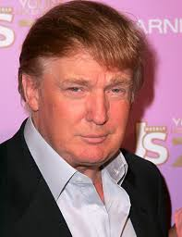
overweening
Connotation: Negative
Etymology: Old English oferwenian "to be proud, become insolent or presumptuous;“
Word Structure: with the sense of “over the limit,” “to excess,” “too much,” “too,”

Slide 17
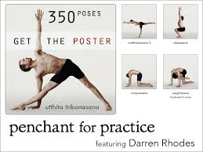
Penchant
Connotation: Neutral
Etymology: O.Fr. pencher "to incline," from L.pendere "to hang"

Slide 18
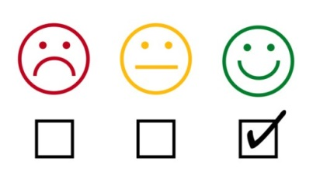
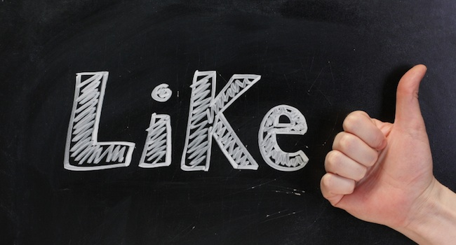
Reputed
Connotation: positive
Etymology:
Latin reputāre to compute, consider, equivalent to re+ putāre to think

Slide 19
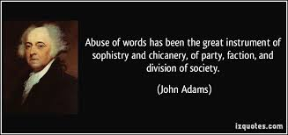
Sophistry
Connotation: negative
Etymology:
Latin from sophos "skilled in a handicraft, cunning in one's craft”

Slide 20
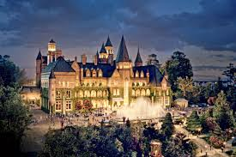
Sumptuous
Positive Connotation
Etymology: from L. sumptuosus "costly, expensive," from sumptus "cost, expense," pp. of sumere "spend, consume, take"
Word Structure: “ous” Means “full of, given to”

Slide 21
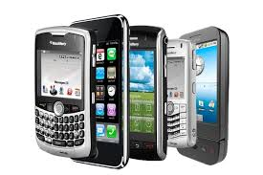
Ubiquitous
Latin ubiquitarius, from ubique "everywhere," from ubi "where" + que "any, also, and, ever"
connotation : Neutral

