Slide 1
Unit 6
Level G

Slide 2
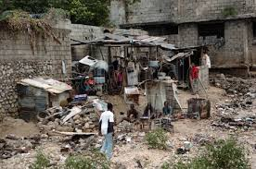
Abject
Connotation: Negative
Etymology: abjectus thrown down ab- + -jec- throw

Slide 3
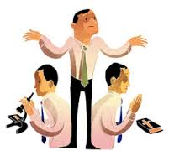
Agnostic
Connotation: neutral
Etmyology: Greek variant of ágnōtos not
known, incapable of being known
a=not; gnōtós=known

Slide 4
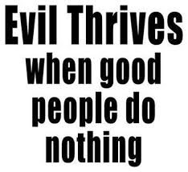
Complicity
Connotation: negative
Etymology: Latin complicare “fold together;”
Middle English complice “associate;”
English complicate

Slide 5
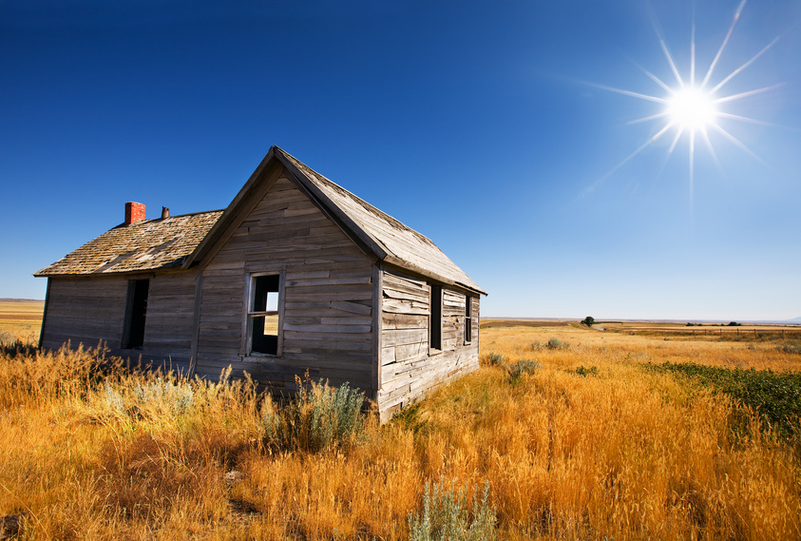
Derelict
Negative
Latin dērelictus forsaken
past participle of relinquere to leave, abandon; see relinquish

Slide 6
Diatribe
Connotation: negative
Etymology:
Latin diatriba learned debate, Greek diatribē discourse, pastime, from diatribein to whileaway, from dia- tribein to rub

Slide 7
effigy
Connotation: neutral
Etymology: Latin effigia, equivalent to effig- ( fig- shape, form; see figure )

Slide 8
equity
Connotation: neutral
Etymology: from Latin aequitatem "equality, conformity, symmetry, fairness," from aequus "even, just, equal"

Slide 9
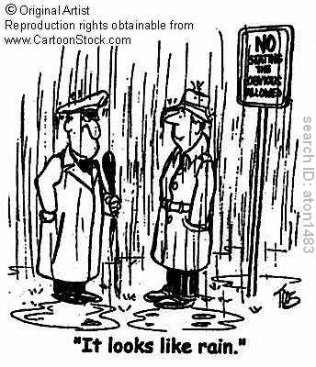
inane
Connotation: negative
Etymology: "silly, empty-headed," 1819, earlier "empty" (1660s),a back-formation from inanity.

Slide 10
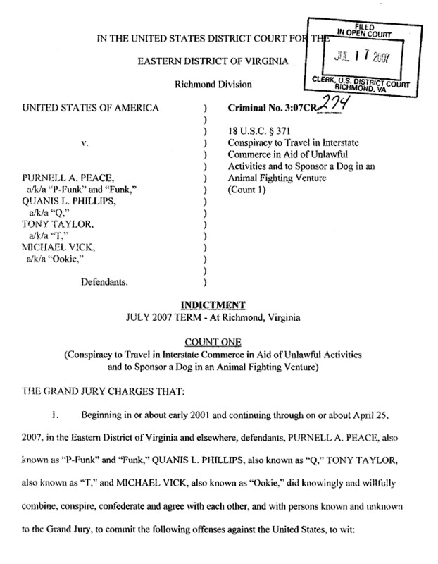
indictment
Connotation: neutral
Etymology: Latin
*indictāre,
derivative of Latin
indīcere to announce,
proclaim.

Slide 11
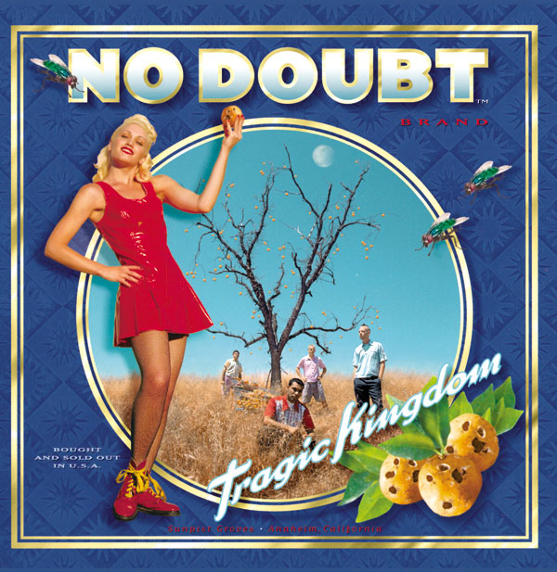
indubitable
Connotation: positive
Etymology: Latin dubitābilis, equivalent to dubitā to doubt

Slide 12
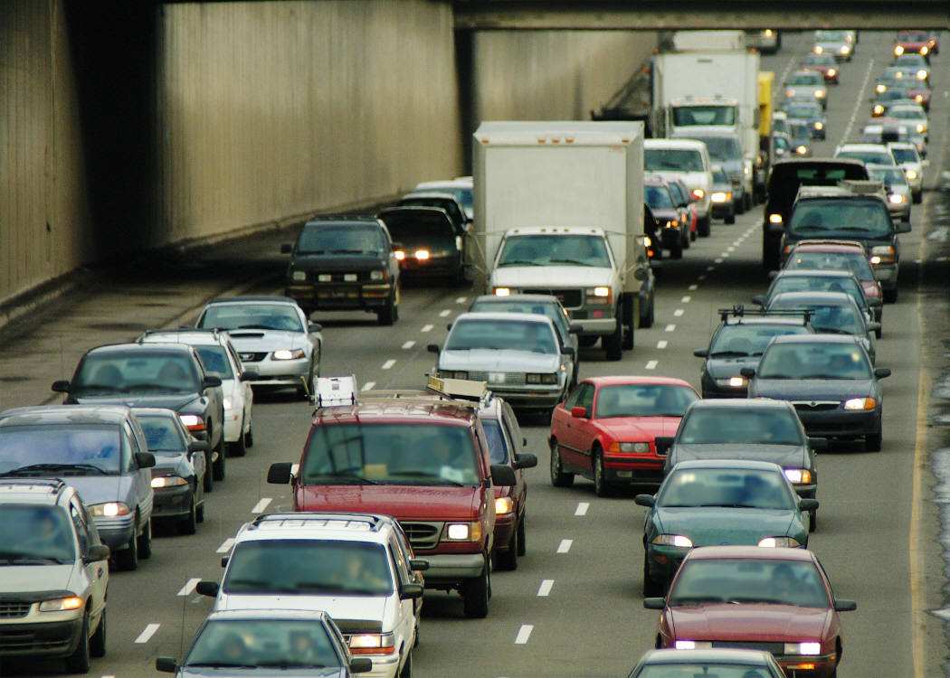
Intermittent
Connotation: Negative
Etymology: Latin intermittent-, intermittens, present participle of intermittere

Slide 13
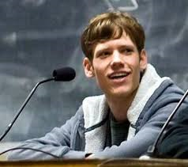
Moot
Connotation: Neutral
Etymology: Middle English mot (e) meeting, assembly, Dutch gemoet meeting.

Slide 14
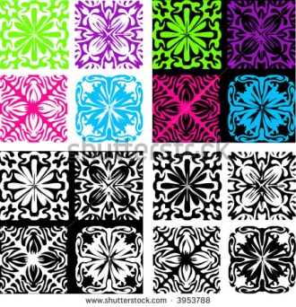
Motif
Connotation: neutral
Etymology: French; see motive>< Medieval Latin mōtīvus serving to move

Slide 15
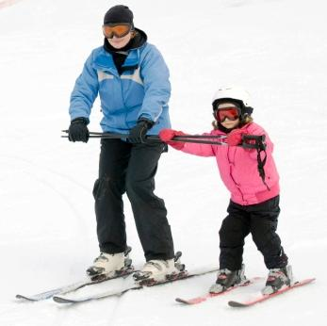
Neophyte
Late Latin neophytus newly planted < Greek neóphytos. See neo-, -phyte
Neutral Connotation

Slide 16
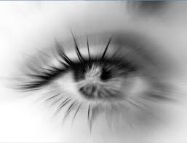
perspicacity
Connotation: positive
Etymology: Late Latin perspicācitās sharpness of sight, (stem of perspicāx sharp-sighted)

Slide 17
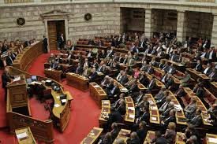
plenary
Connotation: neutral
Etymology: from Latin plēnus full

Slide 18

Surveillance
Connotation: negative
Etymology: French, from surveiller to watch over, from sur- + veiller to watch, from Old French veillier, from Latin vigilare, from vigil watchful

Slide 19

Sylvan
Connotation: Neutral
Etymology: Medieval Latin silvanus, from Latin silva, sylva wood.

Slide 20
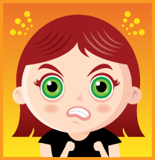
Testy
Connotation: negative
Etymology: alteration of MiddleFrench testu headstrong

Slide 21
Travesty
Connotation: negative
Etymology: <Latin equivalent to tra- ( trāns- ) + vestire to clothe
View Liam Martin’s recreation of celebrity photos:
http://www.evoke.ie/now/teens-instagram-pictures-perfectly-mimic-his-favourite-celebrities-from-katy-perry-to-kim-kardashian-and-everyone-in-between/

