Slide 1
Vocabulary
Unit 7

Slide 2
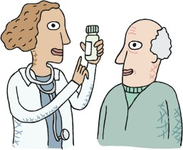
ALLAY
Connotation: positive
Etymology: Old English ālecgan to put down, allay ( ā- + lecgan to lay)

Slide 3
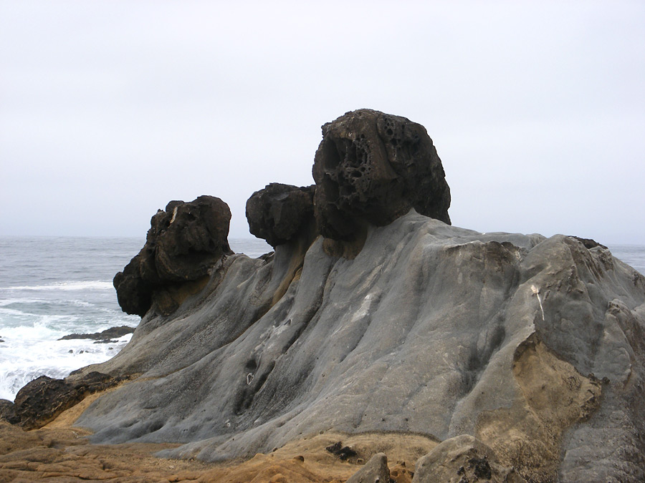
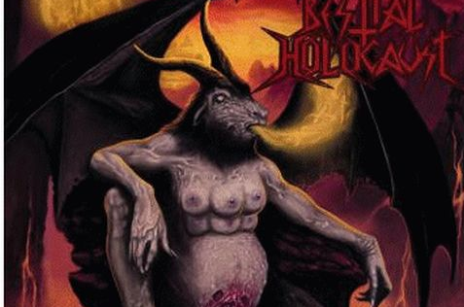
BESTIAL
Connotation: neutral, negative
Etymology:Latin bēstiālis (Latin bēsti beast )

Slide 4
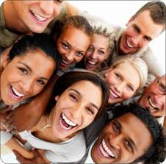
Convivial
Connotation: Positive
Etymology: Latin convīvi (um) feast
( convīv (ere) to live together, dine together
( con- con- + vīvere to live)

Slide 5
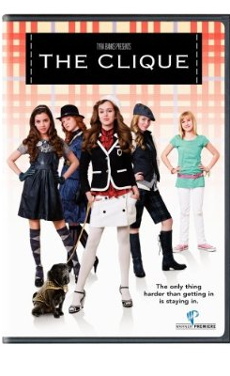
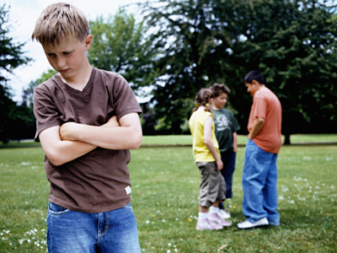
COTERIE
Connotation: neutral
Etymology: Old French: association of tenants, from cotier cottager, from Medieval Latin cotārius cotter

Slide 6
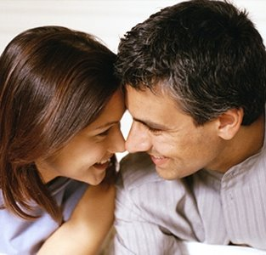
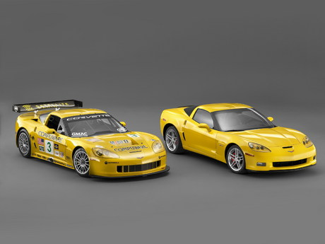
COUNTERPART
Connotation: neutral
Etymology: originally countre part "duplicate of a legal document," from MidFrench contrepartie, from contre "facing, opposite" + partie "copy of a person or thing," originally past participle of partir "to divide"

Slide 7
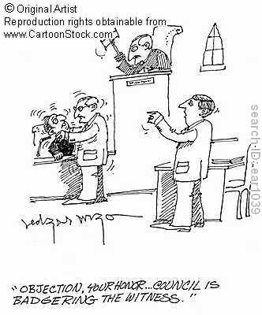
DEMUR
Connotation: negative
Etymology: Latin dēmorārī to linger, equivalent to dē- + morārī to delay

Slide 8
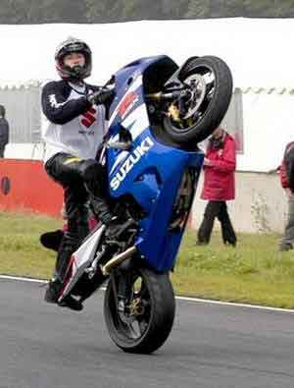
EFFRONTERY
Connotation: negative
Etymology: Old French esfront barefaced, shameless, from Late Latin effrons,
literally: putting forth one's forehead

Slide 9
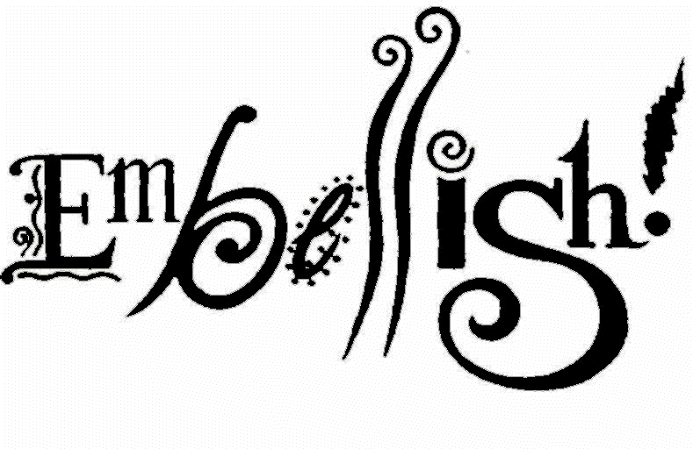
EMBELLISH
Connotation: neutral
Etymology:French embelir, from bel beautiful

Slide 10
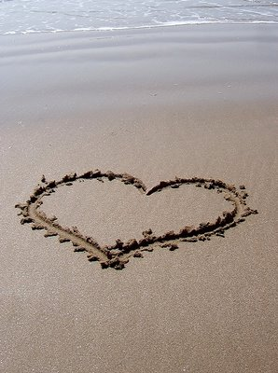
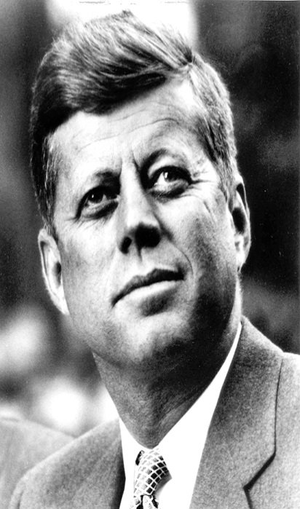
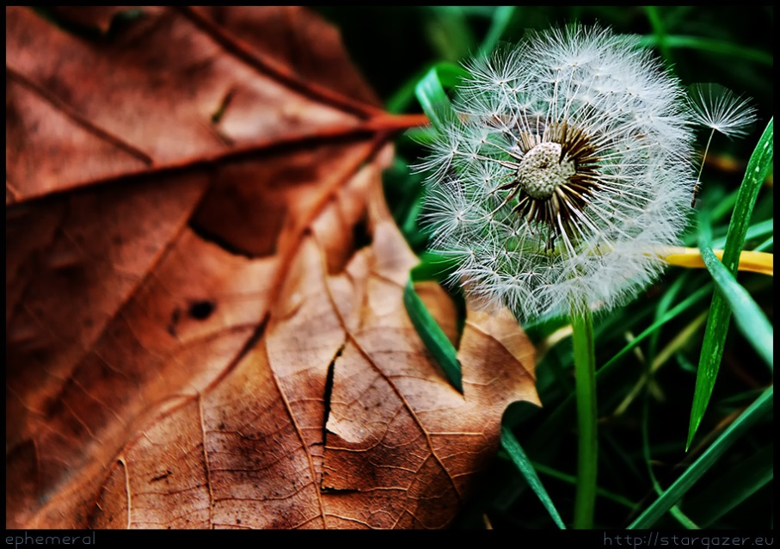
Ephemeral
Connotation- Neutral
Etymology- Greek ephēmeros -lasting only a day,
from hēmera -day

Slide 11
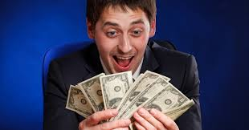
Felicitous
Connotation: Positive
Etymology: Old French felicite "happiness,"
from Latin felicitatem "happiness, fertility,"
from felix "happy, fortunate, fruitful, fertile,"
from Latin root *fe-, "to suck, suckle, produce, yield" (see fecund).

Slide 12
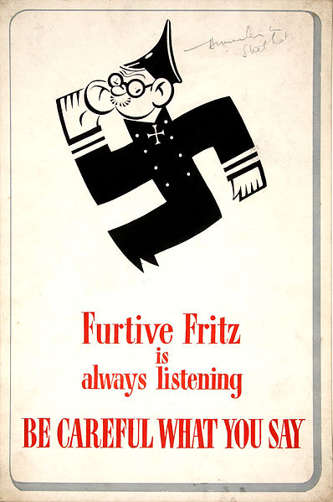
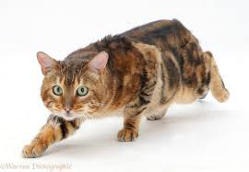
FURTIVE
Connotation: negative
Etymology: Latin furtīvus stolen, clandestine, from furtum a theft, from fūr a thief
British WWII Anti-German Propaganda

Slide 13
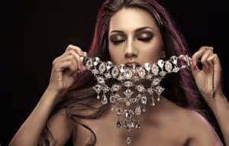
GARRISH
CONNOTATION: NEGATIVE
ETYMOLOGY: Middle English gawren "to stare" (perhaps from Old Norse gaurr "rough fellow")

Slide 14
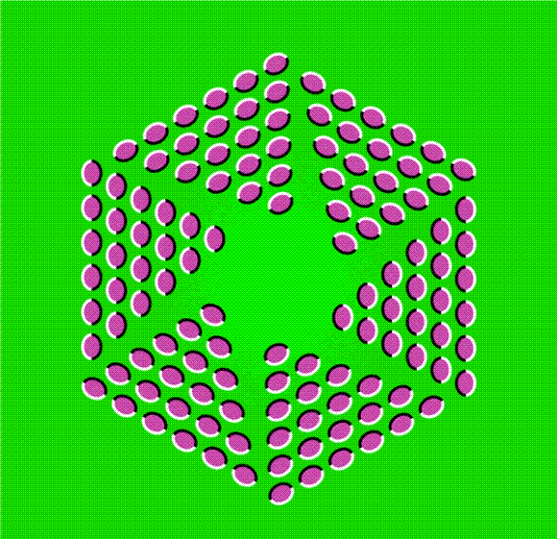
ILLUSORY
Connotation: negative
Etymology: Late Latin illusorius "ironical, of a mocking character,"
from illus-, past participle stem of Latin illudere "mock at,"
literally "toplay with," (in- + ludere "to play" (see ludicrous )

Slide 15
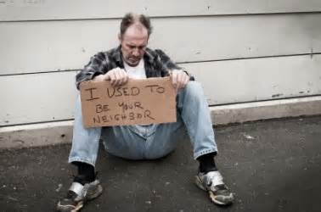
INDIGENT
CONNOTATION: NEGATIVE
ETYMOLOGY: Latin indigēre to need, from egēre to lack

Slide 16
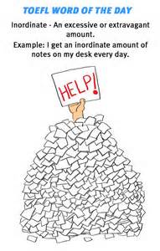
INORDINATE
CONNOTATION: NEGATIVE
ETYMOLOGY: Latin inordinātus disordered, from in- +ordināre to put in order

Slide 17
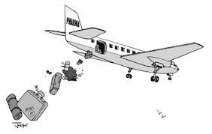
Jettison
Connotation: neutral
Etymology: Old French getaison, ultimately from Latin jactātiō a tossing about

Slide 18
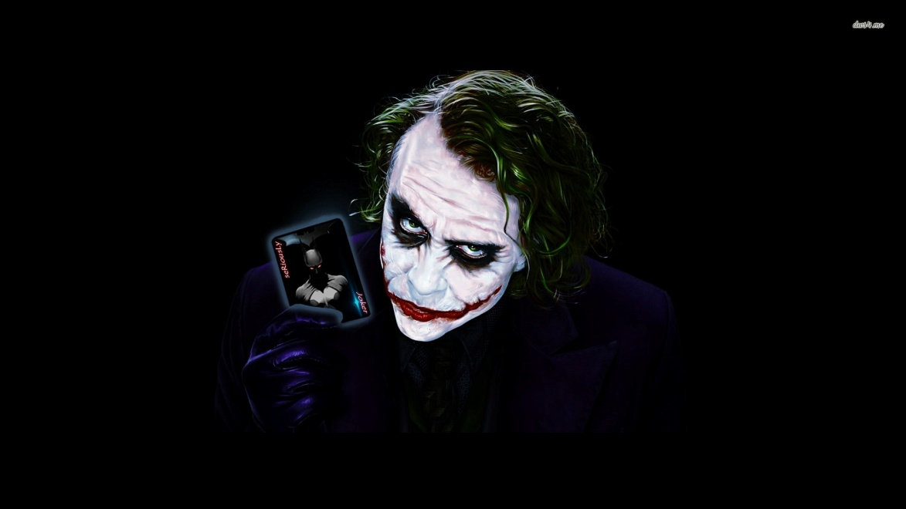
Misanthrope
Connotation: negative
Etymology: Greek mīsanthrōpos,
from misos hatred +anthrōpos man

Slide 19
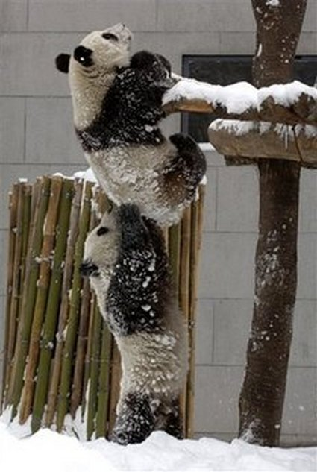
PERTINACIOUS
Connotation: negative
Etymology: Latin pertināx,
from per- (intensive) +
tenāx clinging, from tenēre to hold

Slide 20
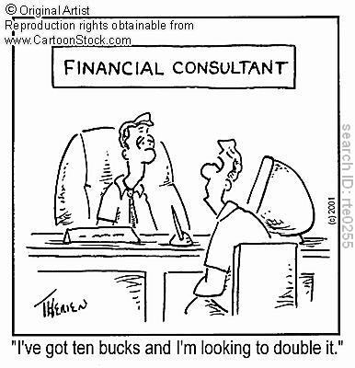
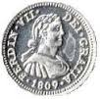
PICAYUNE
Connotation: negative
Etymology: Provençal picaioun small copper coin(compare French picaillons)

Slide 21
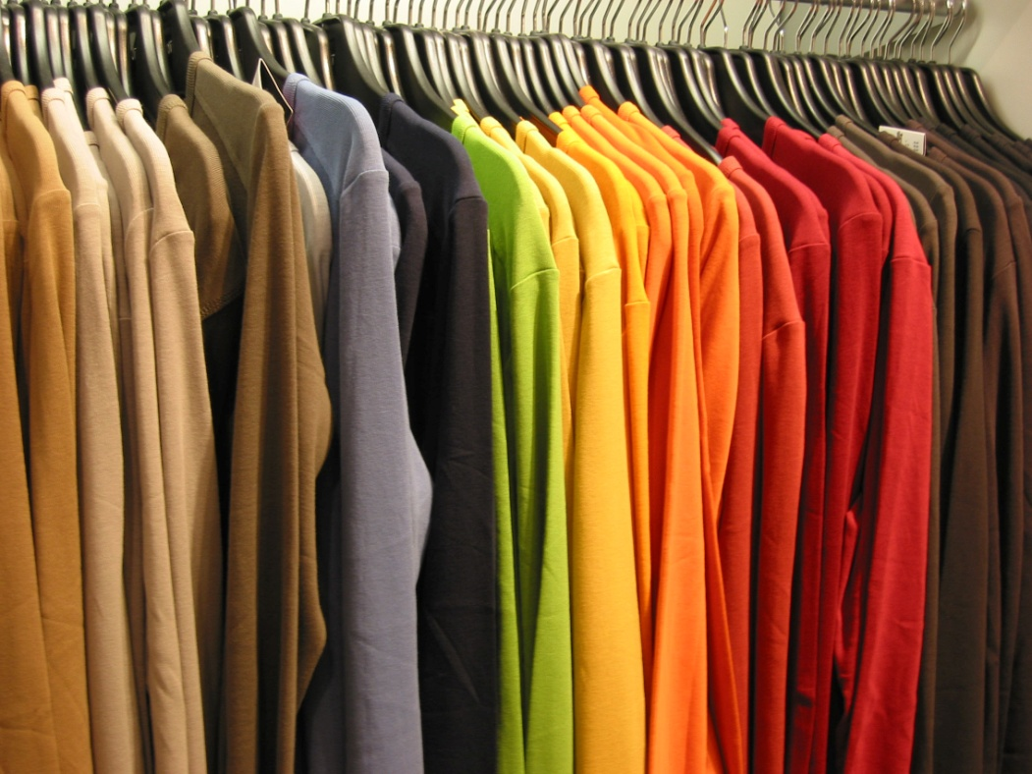
Raiment
Connotation: Neutral
Etymology: shortening of arayment "clothing",
from Old French areement, from areer "to array"

